Slide 1


TRAFFIC LIGHT CONTROLLER
Based on AT89C51 Microcontroller
Presented By:
FA17-BCE-014
FA17-BCE-052
FA17-BCE-087

Slide 2
INTRODUCTION
Traffic lights have become an integral part of human’s day-to-day life.
With this motivation in the mind, this project aims at designing and implementing, a running model of traffic light controller which is controlled by time based.
We will use AT89c51 microcontroller for performing all the computation and control related task

Slide 3
Purpose
Control up to 4-way traffic system with the traffic flow optimization strategies
Optimize the traffic flow at network junctions
Measurably improve traffic flow
Reduce environmental pollution caused by traffic
Most importantly increases road safety

Slide 4
RED
Come to complete stop at stop line or before crosswalk or intersection.
After stopping, you may turn right on red at most intersections if the way is clear.
Some school districts have local policies that prohibit right turns on red by bus operators.
Some intersections display “NO TURN ON RED,” which you must obey.

Slide 5
YELLOW
Stop if you can do so safely.
The light will soon be red.
GREEN
Go, but only if intersection is clear.
If turning left, wait for gap in oncoming traffic to complete turn.

Slide 6
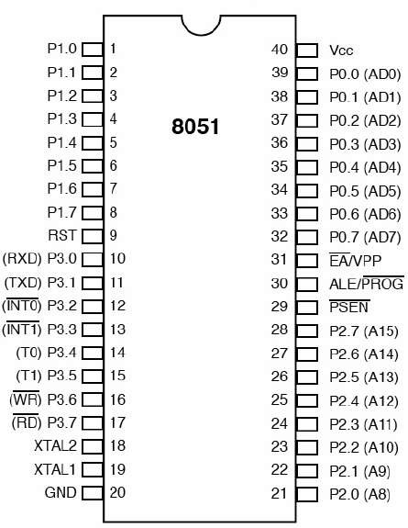
Few things about AT89C51
It has four Ports:
Port 0
Port 1
Port 2
Port 3
These Four ports works as Input port as well as output port.

Slide 7
FEATURES OF TRAFFIC LIGHT CONTROLLER
controller assumes equal traffic density on all the roads.
The free left turn condition is provided throughout the entire signal period.

Slide 8
COMPONETS
AT89C51 Microcontroller
Resistor (10KΩ)
LED light (Red, Green, Blue)
Seven Segment display
Power supply

Slide 9
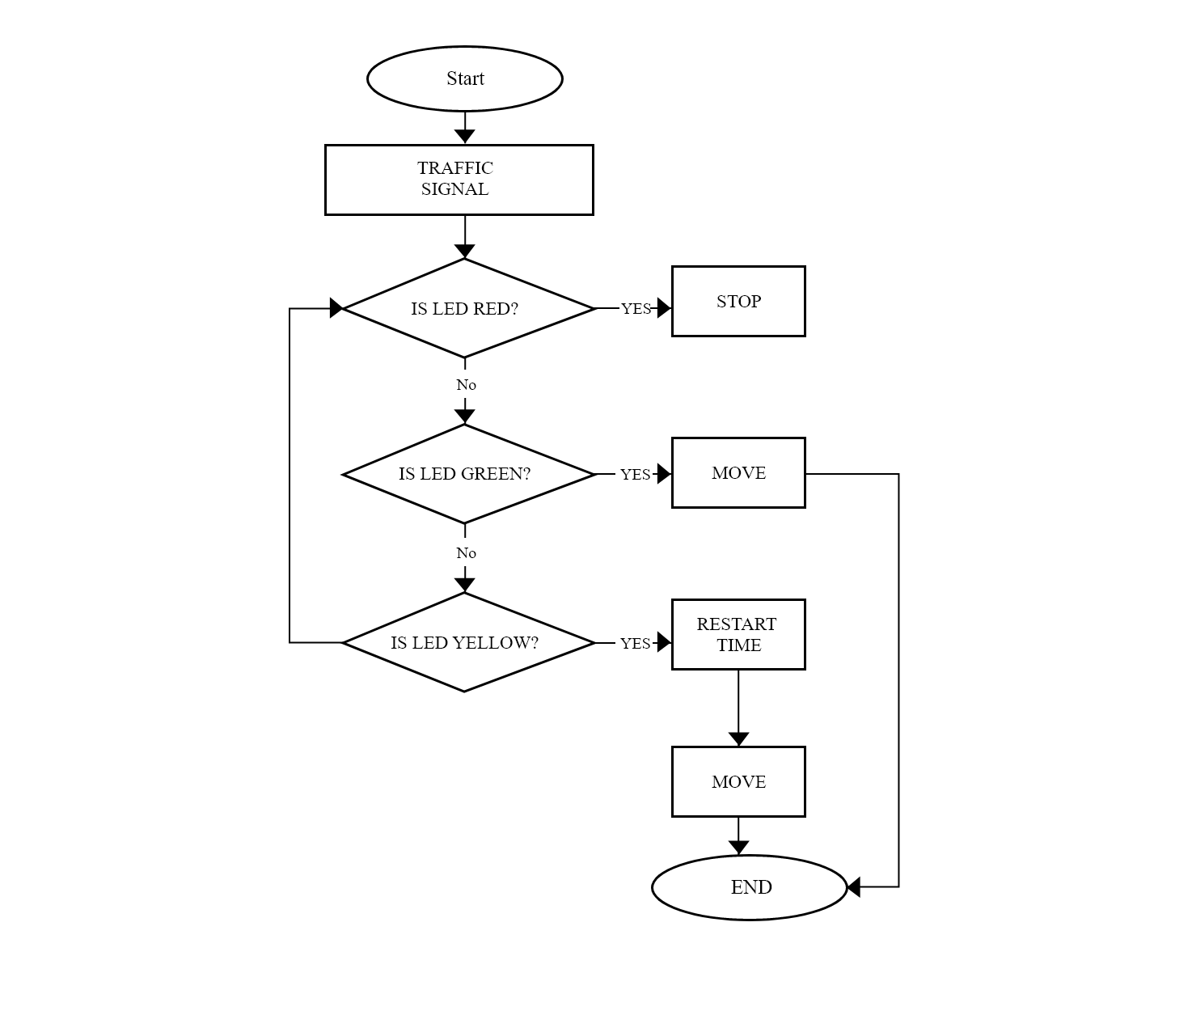
Flow chart

Slide 10
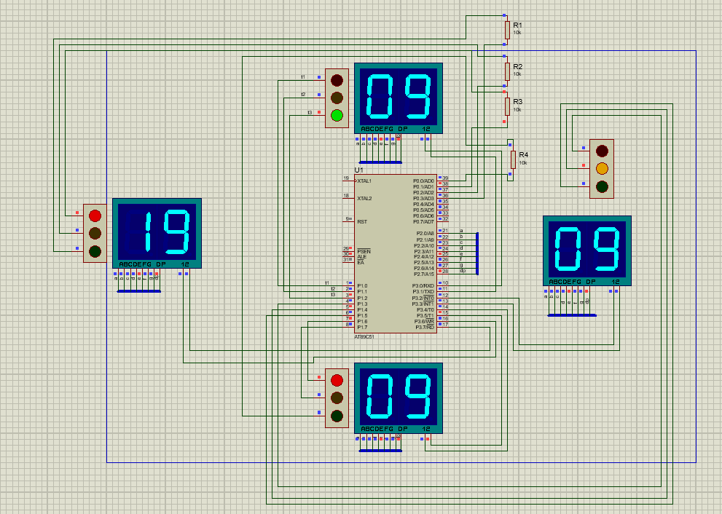
CIRCUIT DIAGRAM

Slide 11
WORKING
The pins of the various input output ports of the microcontroller are connected directly to the given LEDs.
The 8051 is programmed in a manner that the
respective LEDs glow by setting the required bit using assembly language and a certain amount of delay is provided depending on the user.

Slide 12
MOTIVATION
The project finds high practical and widespread use.
It is a very primitive application of the microcontroller.
Easy and convenient to be built for a beginner as the coding comprises of basic instructions.

Slide 13
SCOPE
This project can be enhanced in such a way
as to control automatically the signals depending on the traffic density on the roads using sensors like IR detector/receiver module extended with automatic turn off when no vehicles are running on any side of the road which helps in power consumption saving.

Slide 14




